Slide 1

Grocery Sales Market
Ingredients for life

Slide 2

How Big is the Grocery Industry?

Slide 3
Our Study:
we find the grocery market an interesting study. We hope to derive the insights that will help to FORECAST THE SALES MARKET AND In order to do THAT we analyzed a series of dataset from Kaggle which describes grocery market sales.

Slide 4
Presentation Outline
Which are the Allergic and Non-Allergic Products in different categories?
To identify total sales revenue per product in grocery sales market.
What is the product resistance(perishable/durable) in the sales?
What is the normal distribution of customers over all cities?
Analyze sales transaction by Product and Employee

Slide 5

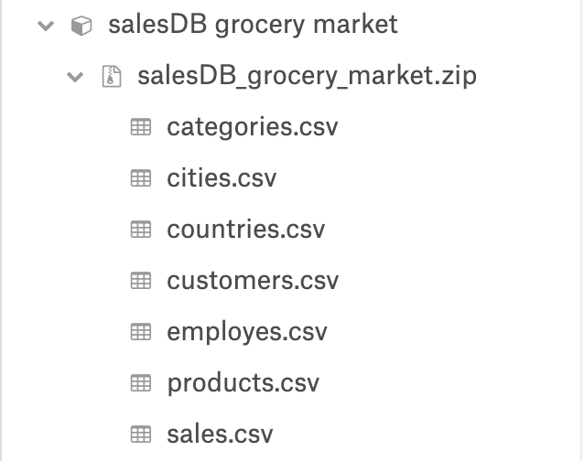
Data Sources

Slide 6
Allergic and Non-Allergic Products

Slide 7

What Products Make Up This Industry ?
Confections
Shell fish
Cereals
Dairy
Beverages
Seafood
Meat
Grain
Poultry
Snails
Produce

Slide 8

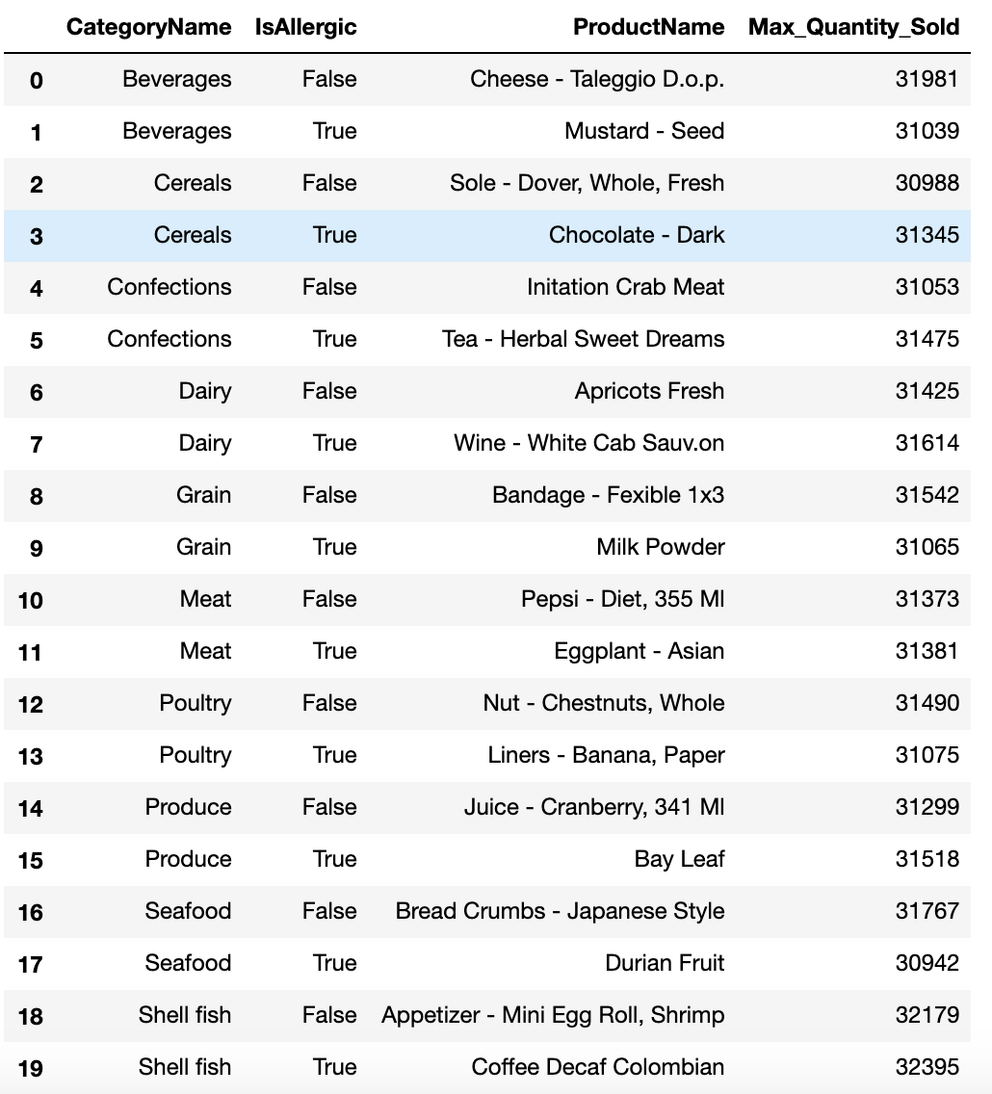



Common allergic & non-allergic products among different categories

Slide 9
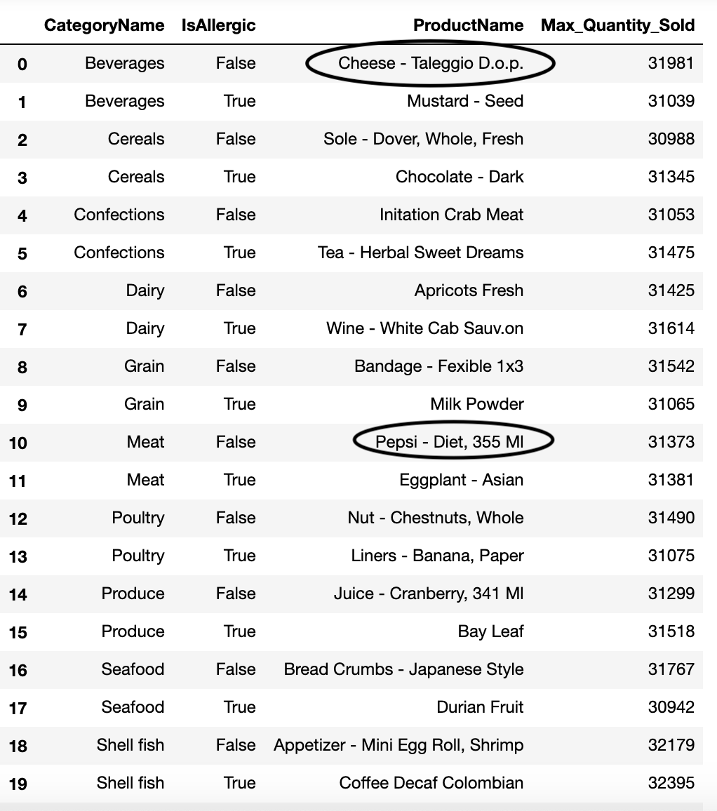
Common allergic & non-allergic products among different categories

Slide 10
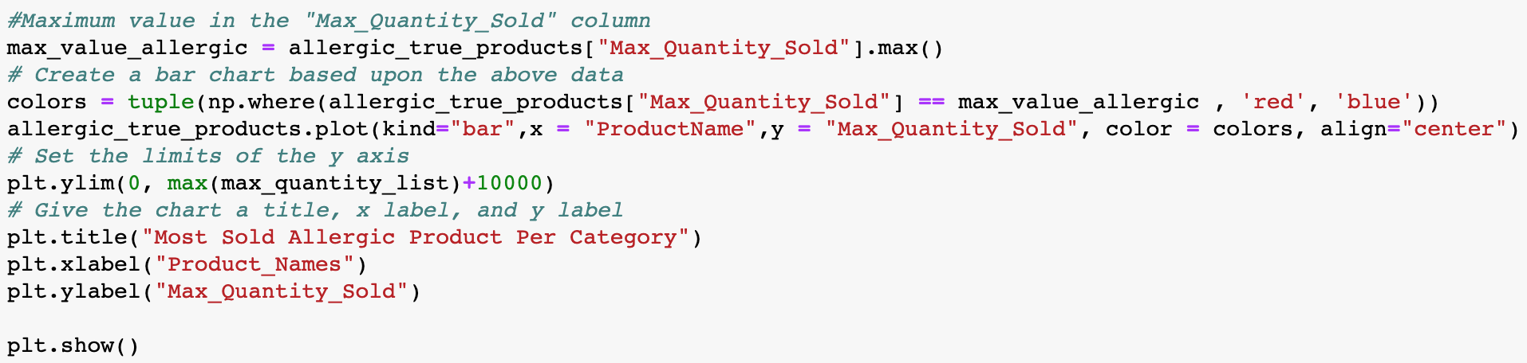
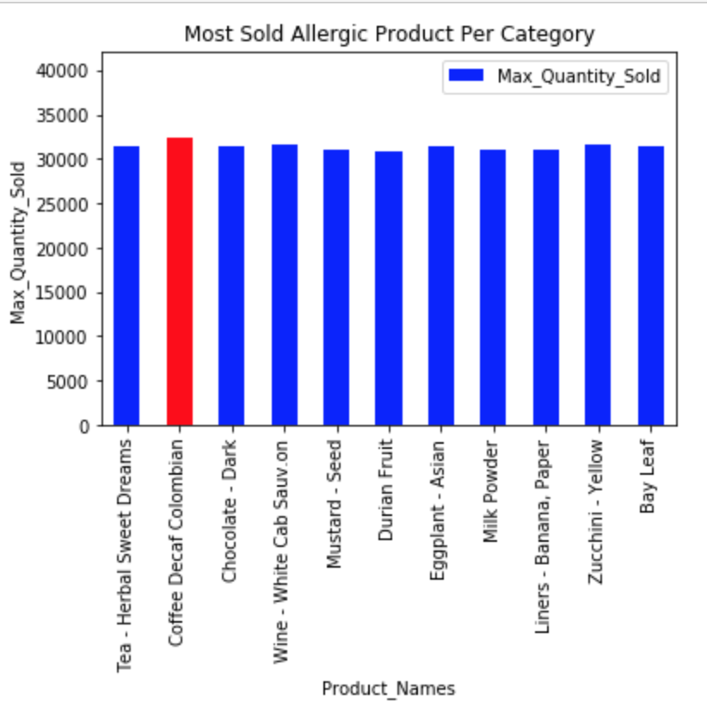
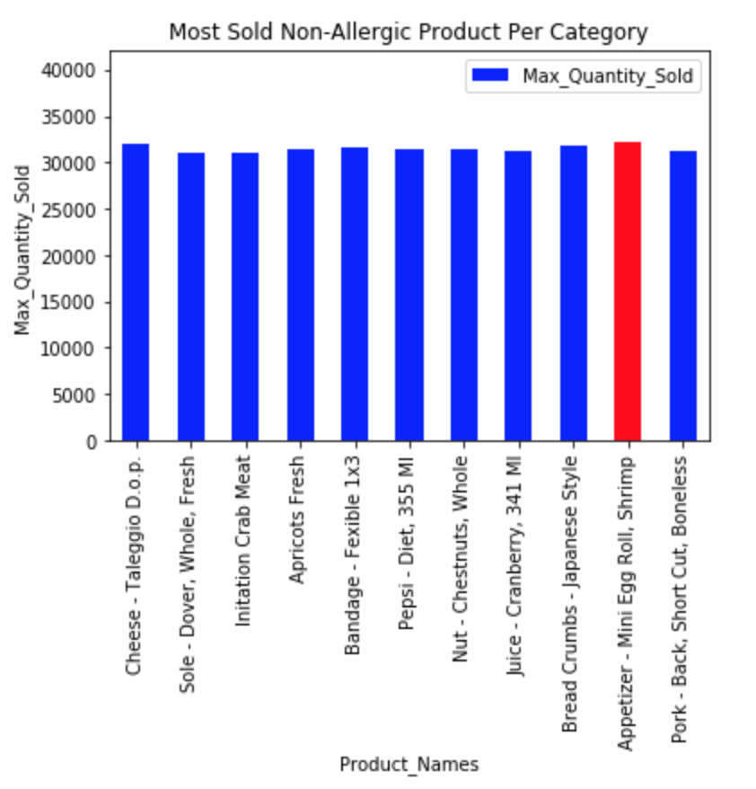
Allergic Products
Non-Allergic Products

Slide 11
Products and Sales
To identify total sales revenue per product in grocery sales market.
A scatter plot showing the distribution
Bar graph showing lowest to highest product sales
Which is most popular product based on sales?
What is the lowest priced product?
What is the product resistance(perishable/durable) in the sales?
A scatter plot showing the distribution
Identify the most perishable and durable items

Slide 12

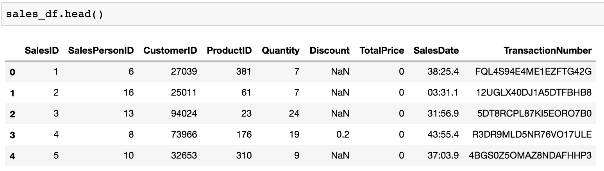
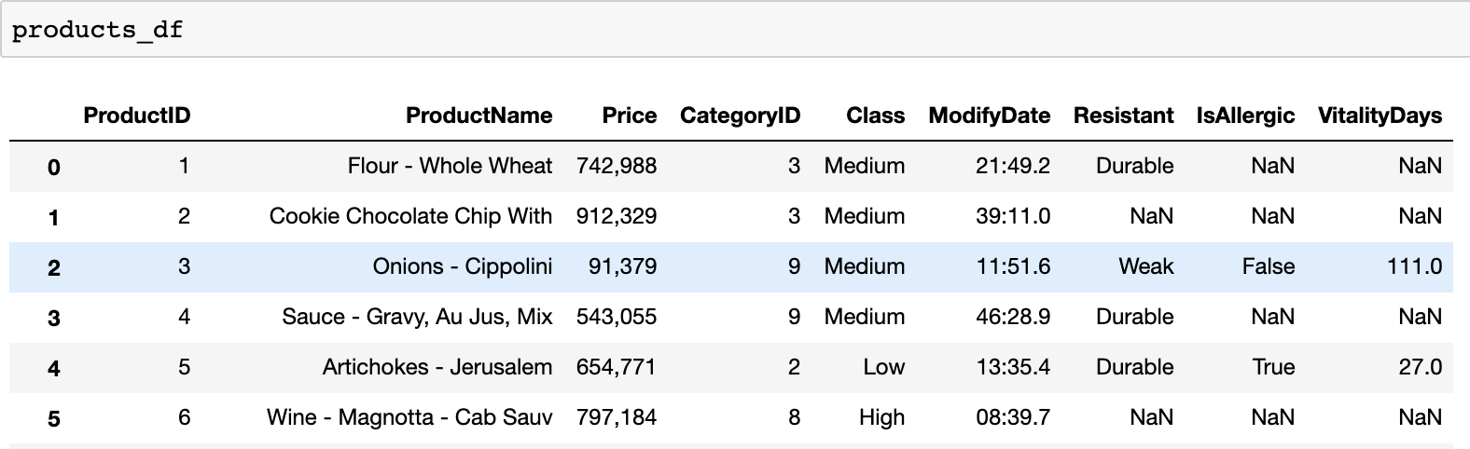
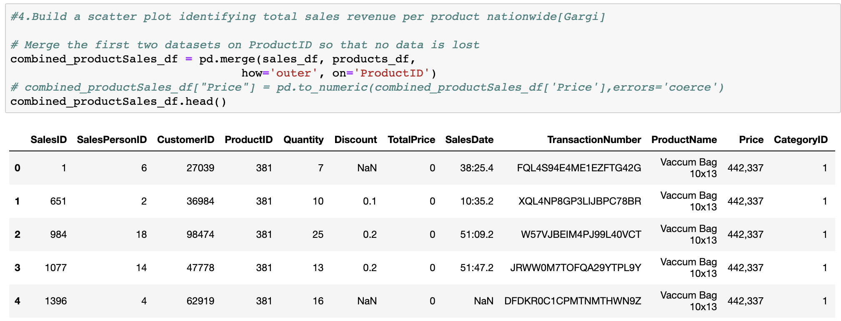
Products and Sales Combined

Slide 13
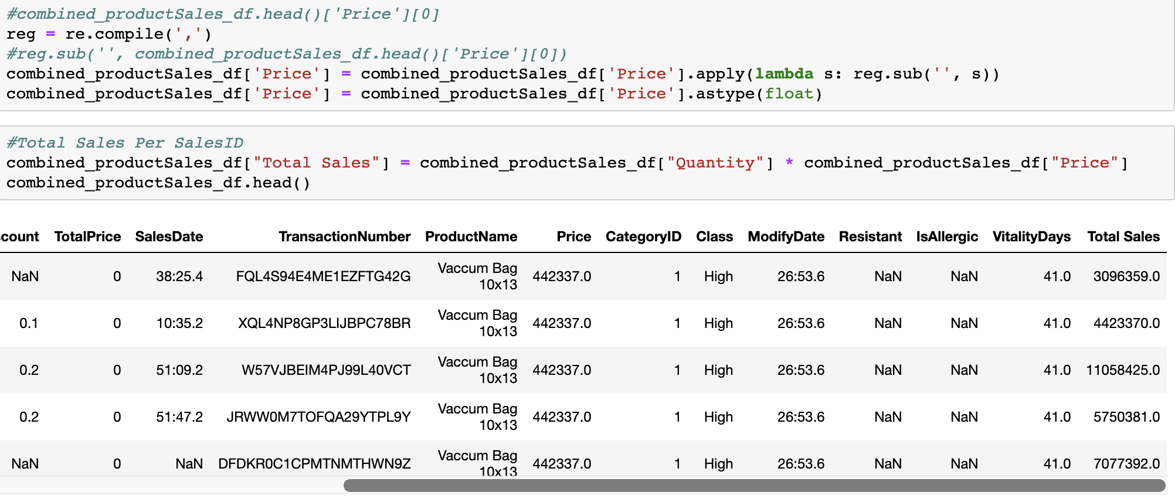
Calculating Total Sales Per Product

Slide 14
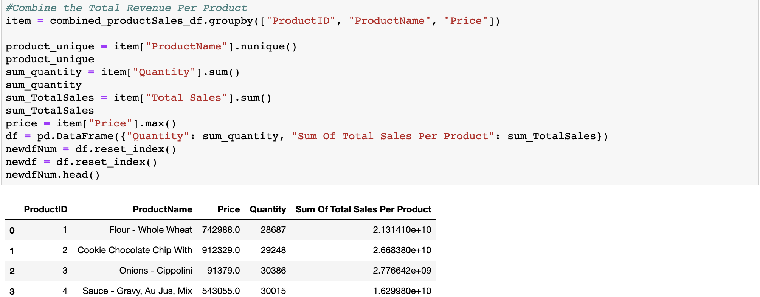
Total Sales Per Product

Slide 15
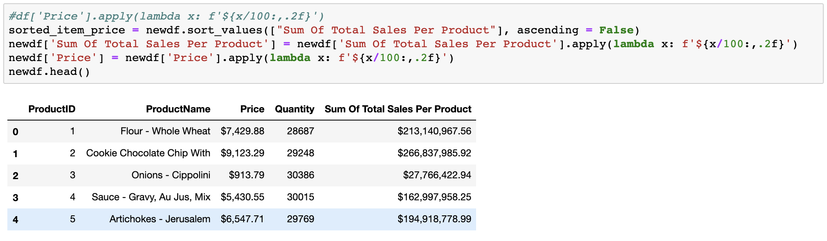
Data Cleanup and Beautification

Slide 16
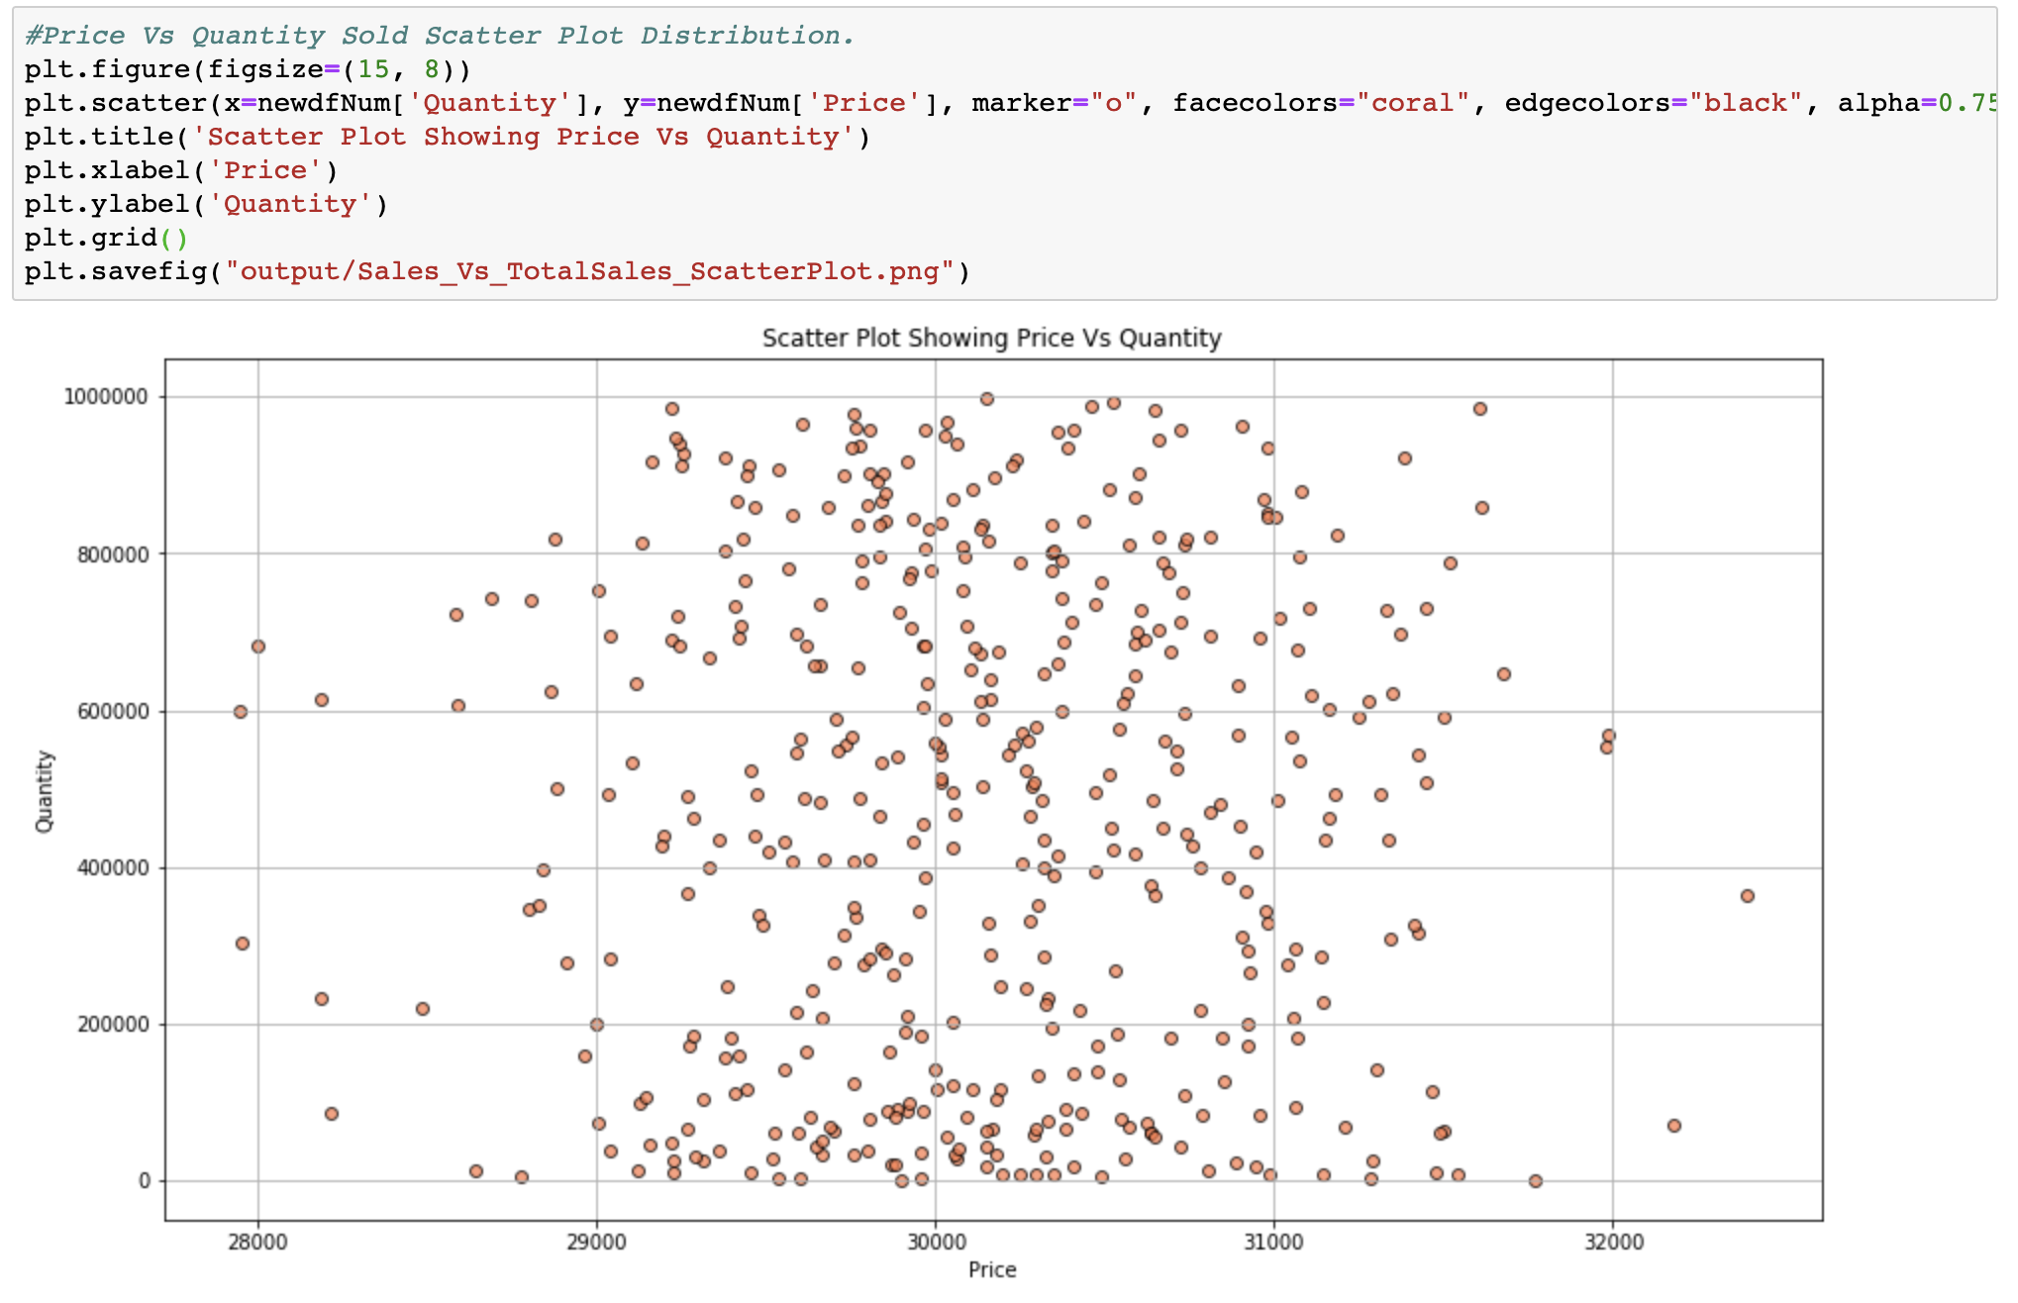
Price Vs Quantity – What does it say?

Slide 17
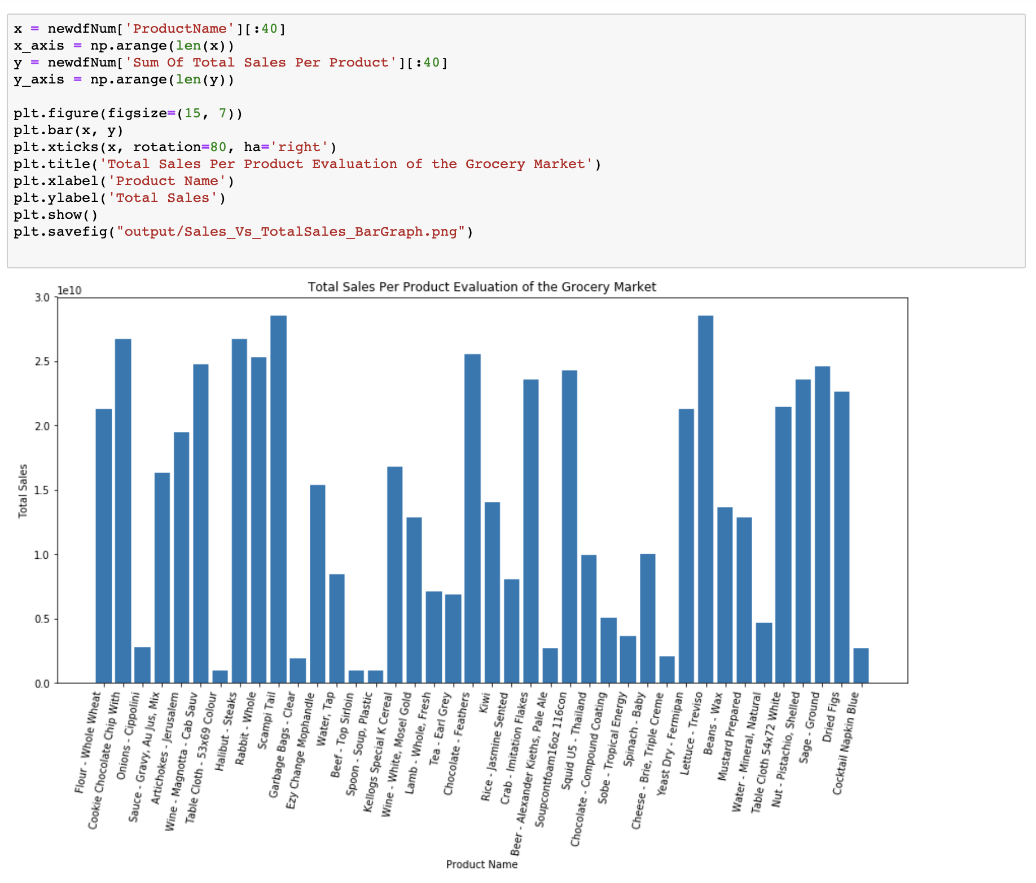

Slide 18
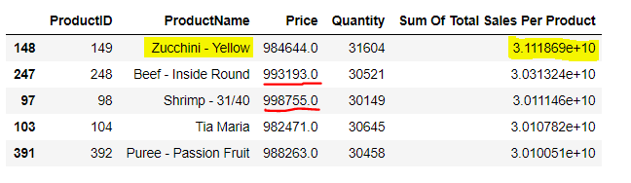
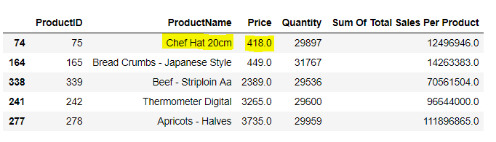
Which is most popular product and least priced product based on sales?

Slide 19
Customers vs Cities
Top 5 cities with the most and least customers.
Normal distribution of customers over all cities.
T test to compare customers in California to customers in all cities

Slide 20
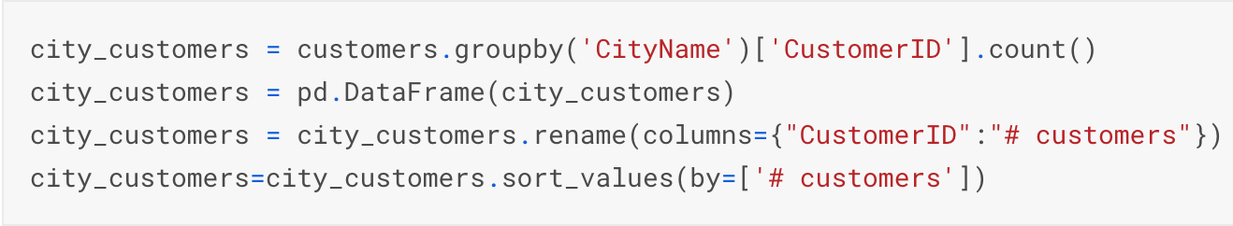
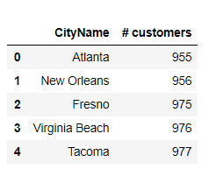
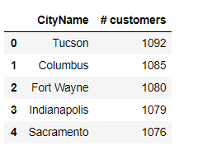
5 Cities with most customers
5 Cities with least customers

Slide 21
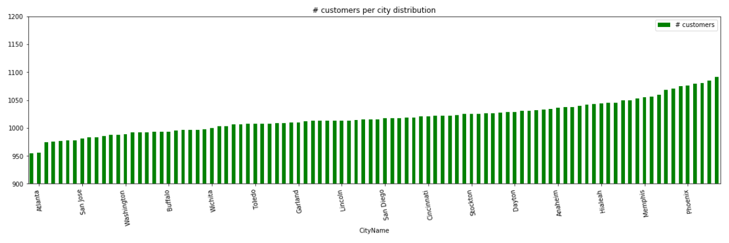
Number of customers per city distribution

Slide 22
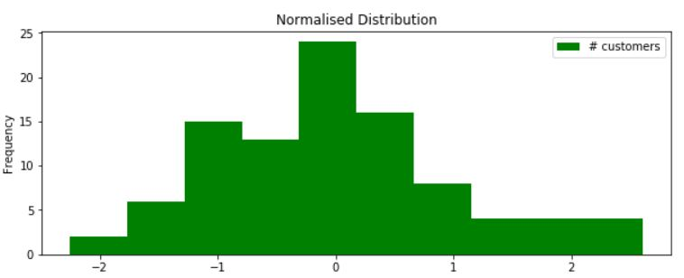
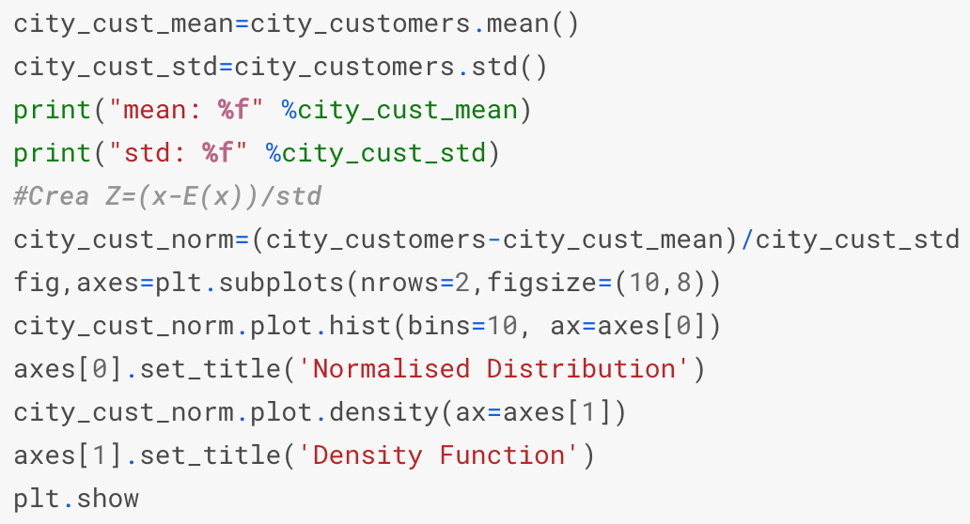
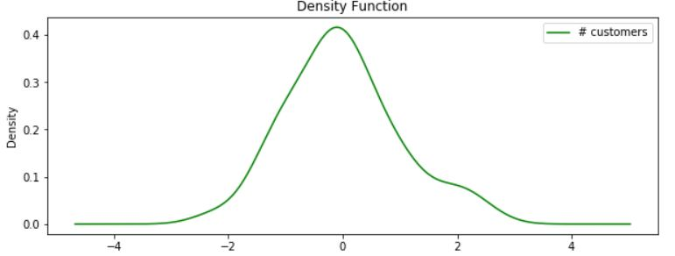
Normal Distribution of Customers
Density Function of Customers

Slide 23
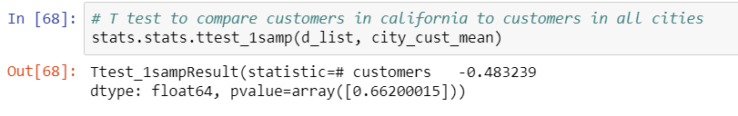
T- test to compare customers in California to customers in all cities

